Slide 1
Refugee Resettlement
Part One: Understanding the Refugee Situation

Slide 2
WHO is a refugee?
Under both international and U.S. law, a refugee is an individual who…
has fled his or her country of origin
because of a credible fear of persecution
on account of their race, religion, political opinion, national origin, or social group.
Notes:
A refugee is someone who has been forced to flee his or her home country.
As such, refugees can apply for asylum in the United States, a process that could take years. Getting refugee status isn't easy.
The applicants have to prove that if they return to their home country, they'll be injured because of their race, religion, nationality, membership in a particular social group or their political opinion.
An immigrant is someone who chooses to resettle to another country.

Slide 3
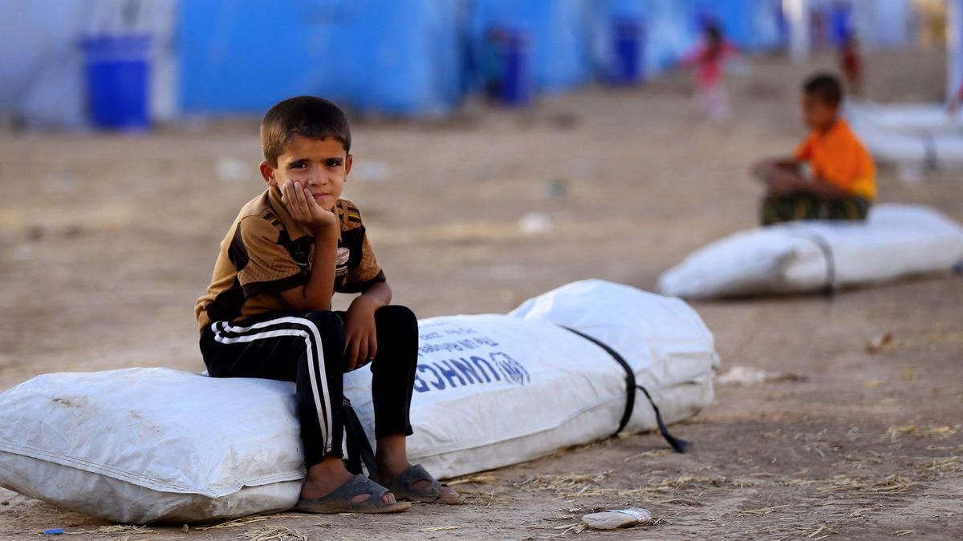
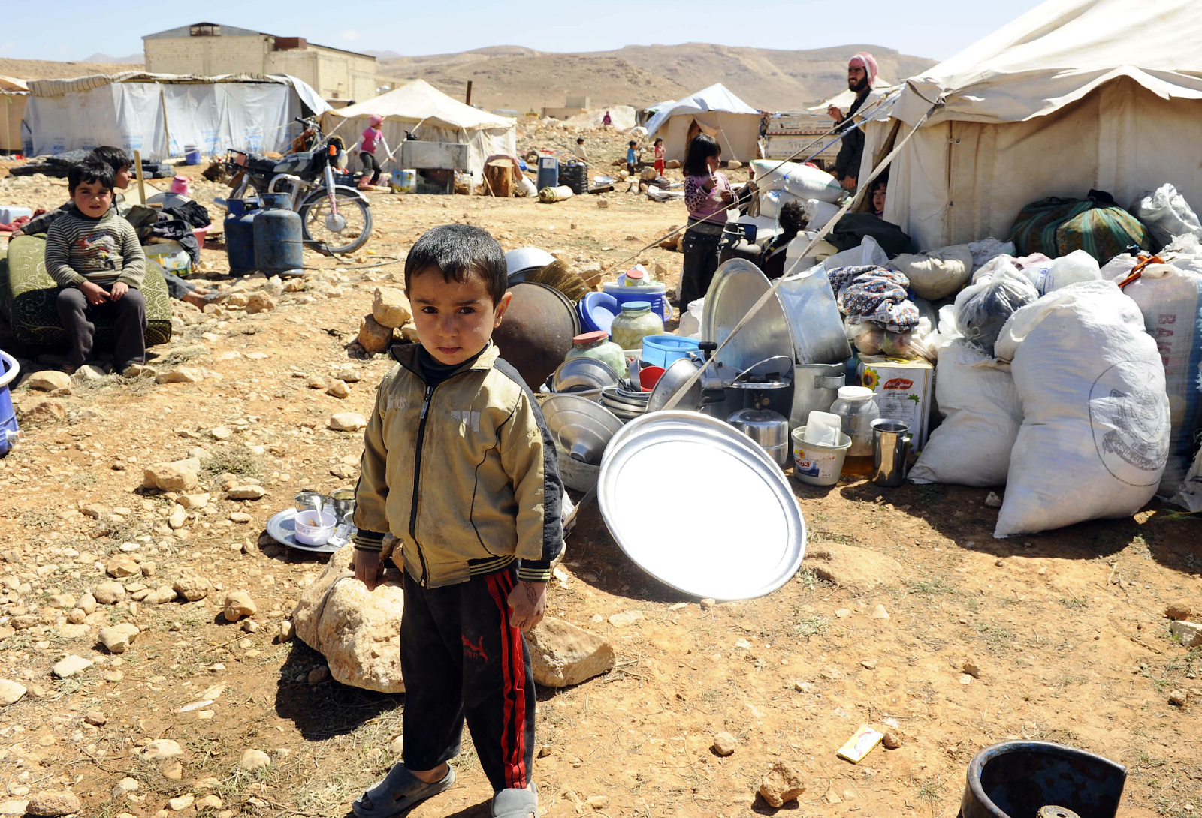
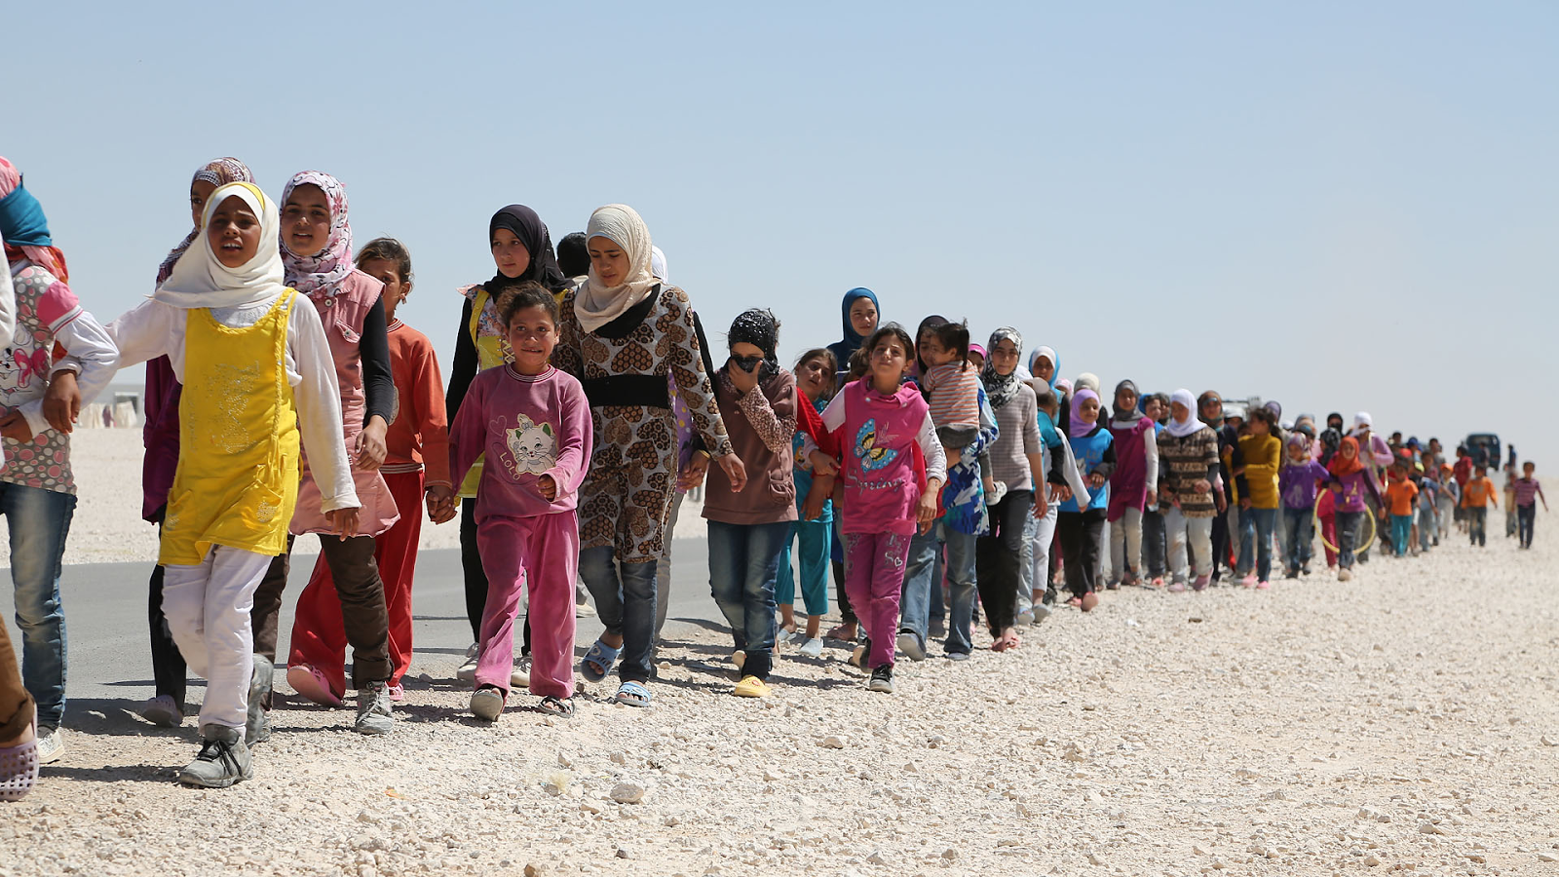
of all refugees are children

Slide 4
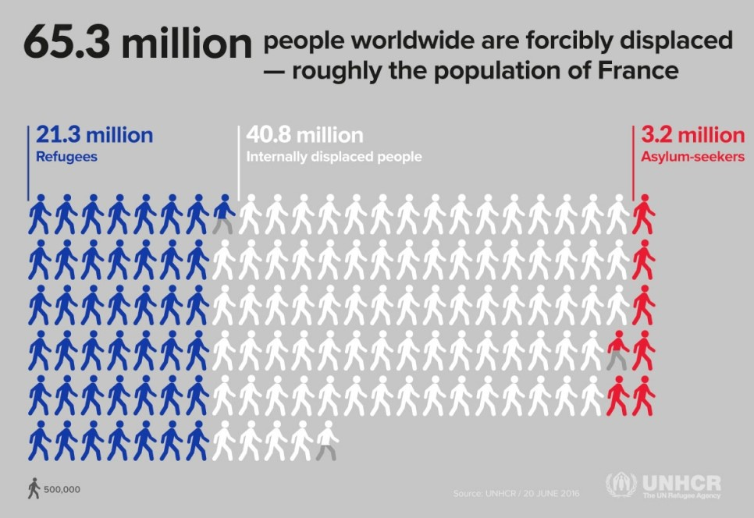

Slide 5
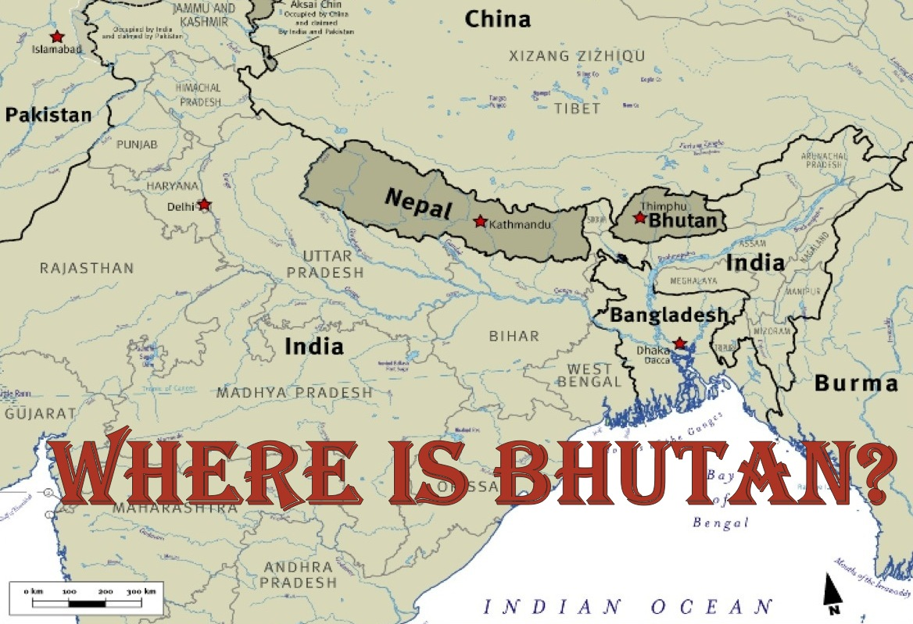
Notes:
Where is the country Bhutan? Bhutan lies in the eastern Himalayas, sandwiched between China and India.

Slide 6
1890’s - Nepali-speaking people are brought to southern Bhutan
1958 - First Citizenship Act -full citizenship is granted to people in southern Bhutan
1985 – Second Citizenship Act - ethnic Nepalis, stripped of their citizenship
1988 - Census operation in Southern Bhutan only/Land tax receipt
1989 - 'One Nation, One People'
1991 - Widespread repression and exodus
2006 - USA makes an offer to take up to 60,000 Bhutanese refugees. Other countries, including Canada and Australia, also indicate openness to receiving some of the refugees.
T
I
M
E
L
I
N
E
Notes:
1890’s - Nepali-speaking people are brought by government contractors to settle in southern Bhutan, to clear the forest and establish rich terraced farmlands, providing the main food supplies for the country.
1958 - Bhutan passes its first Citizenship Act and full citizenship is granted to people in southern Bhutan
1985 - Citizenship Act passed. The government enacted discriminatory citizenship laws directed against ethnic Nepalis, that stripped about one-sixth of the population of their citizenship and paved the way for their expulsion. The Bhutanese government regarded a growing ethnic Nepali population as a threat
1988 - Census operation in Southern Bhutan only. To prove their status, Southern Bhutanese are required to produce a land tax receipt specifically from the year of 1958. People previously recognized as Bhutanese re-classified as 'illegal immigrants'.
1989 - Public unease abounds about the conduct of the census and repressive measures in the south. Under the policy of 'One Nation, One People', Southern Bhutanese are required to wear the northern traditional dress in public and adopt their customs. The Nepali language is removed from the school curriculum. The Hindu Sanskrit schools are closed.
1991 - Repression continues. Citizenship cards are confiscated by government authorities. Many southern Bhutanese government employees are dismissed from service. Homes are burnt and demolished. The exodus of tens of thousands of people via India into Nepal. Southern Bhutanese citizens are forced into signing so-called "voluntary migration forms".
2006 - USA makes an offer to take up to 60,000 Bhutanese refugees.

Slide 7
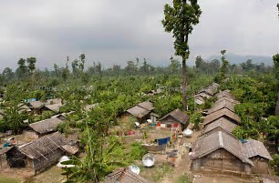
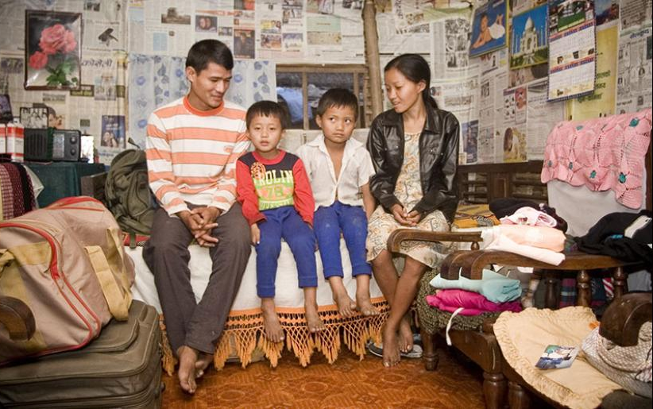
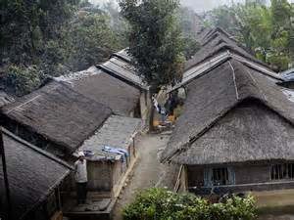
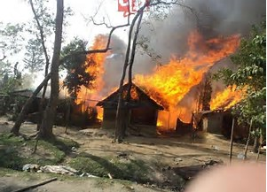
Life in the Refugee Camps
Notes:
The climate is hot and humid, with heavy rains in June and July. In spring, the mountain melt water means that flooding is common.
The structural layout in each camp is very dense, with shelters often under one meter apart. Fires occur frequently and can be very destructive.
Refugees and the local population compete for some environmental resources, such as the collection of dead wood for fuel and the supply of bamboo for construction.
The sites are all located on government forestry department land.
The low-cost, temporary shelters, were made from local materials with an expected lifespan of three years.
One latrine is provided for two households a few meters away from their dwellings
Several international aid organizations help to manage and organize the camps in Nepal. The United Nations High Commissioner for Refugees, the International Organization for Migration, and the World Food Programme are the largest

Slide 8
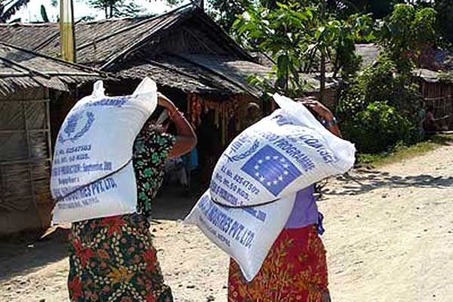
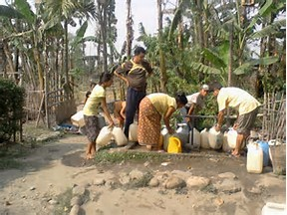
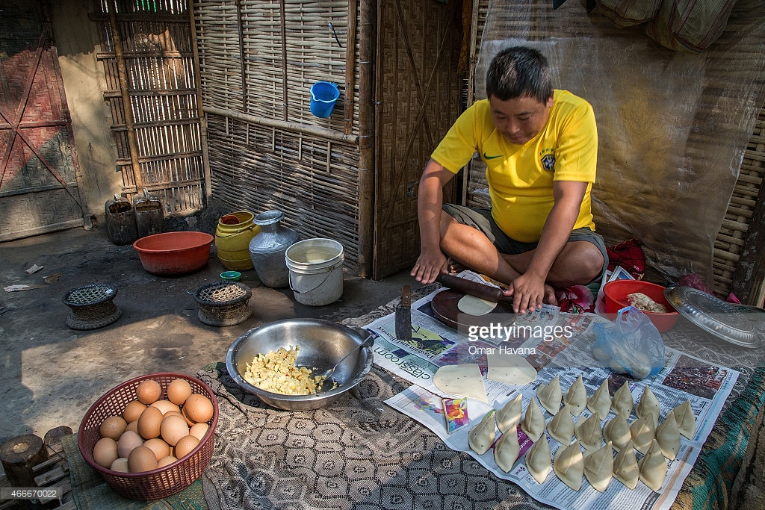
Food & Water
Notes:
The World Food Programme distributes rations every two weeks to households in allotments that allow each person to have 2,100 calories per day, mostly from beans, rice, and vitamin supplements, not fruits or vegetables.
Rations are distributed to each household in proportion to the number of members in the family. There is no variation in quantity according to age; a full grown man receives the same amount as a toddler.
The water system is centrally controlled and distributed through pipes. The water is pumped from deep wells by diesel engines to overhead tanks where the water is then chlorinated and subsequently distributed through pipes two to three times per day to tap stands located throughout the camps.

Slide 9
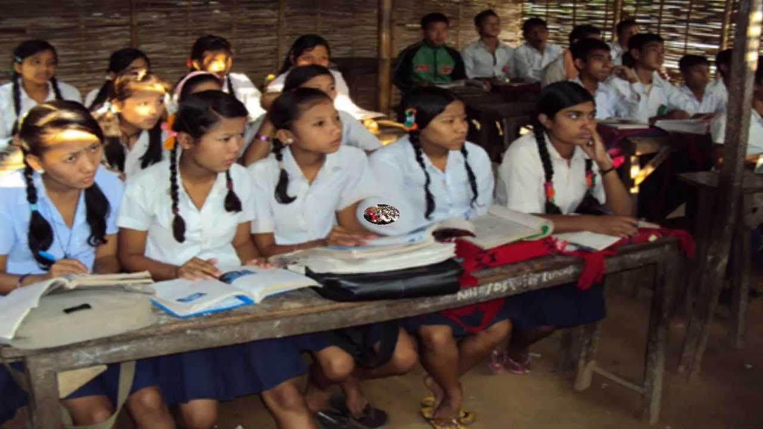
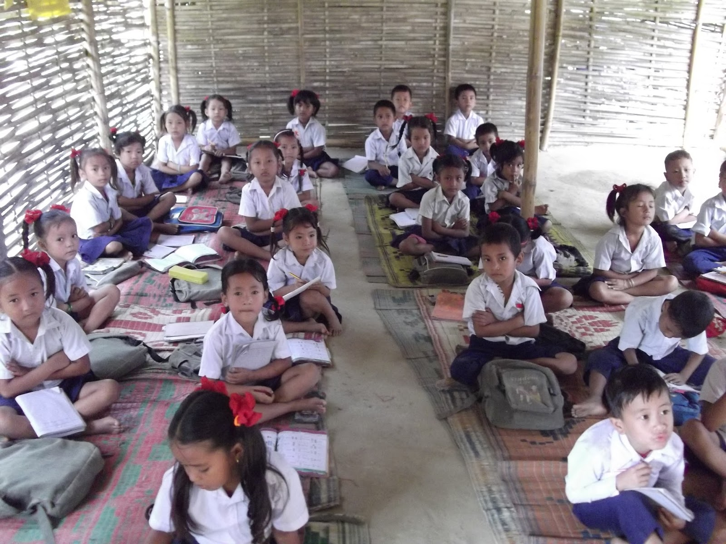
Education
Notes:
The refugee community played a central role in setting up their own education system when the camps were first established. The education program is currently run almost wholly by Bhutanese teachers and staff.
Higher education, classes for 11 and 12 are outside of the refugee camps.

Slide 10
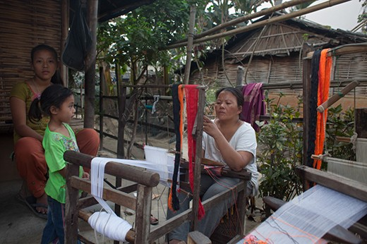
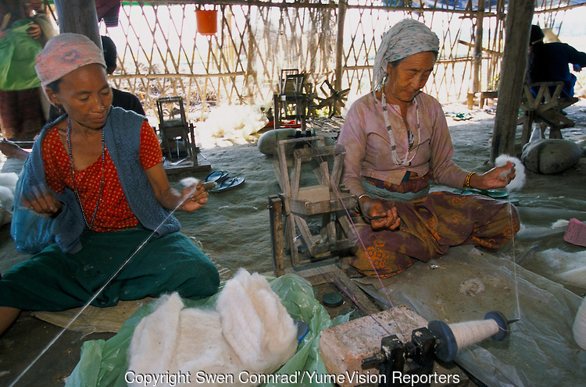
Employment
Notes:
Hard work is mixed with extreme idleness. Refugees must build and repair their own huts and transport heavy loads on their backs. Skilled workers can spend hours sewing or practicing metalwork or carpentry.
The refugees, as per the policies of Government of Nepal, are prohibited from engaging in economic activities outside the camps.
Work in Nepal’s “informal economy” (illegally working) are important revenue streams, providing the means with which families can supplement food rations, purchase clothing, personal items, and materials for their homes.

Slide 11
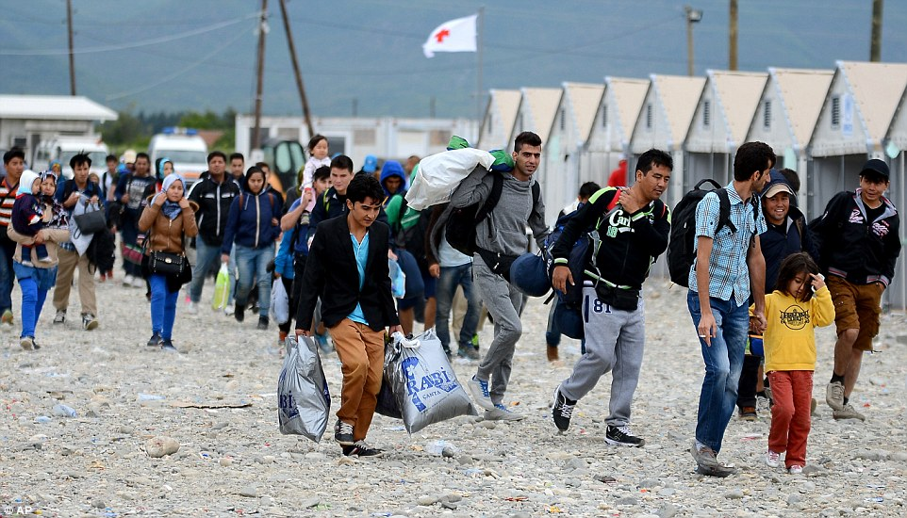
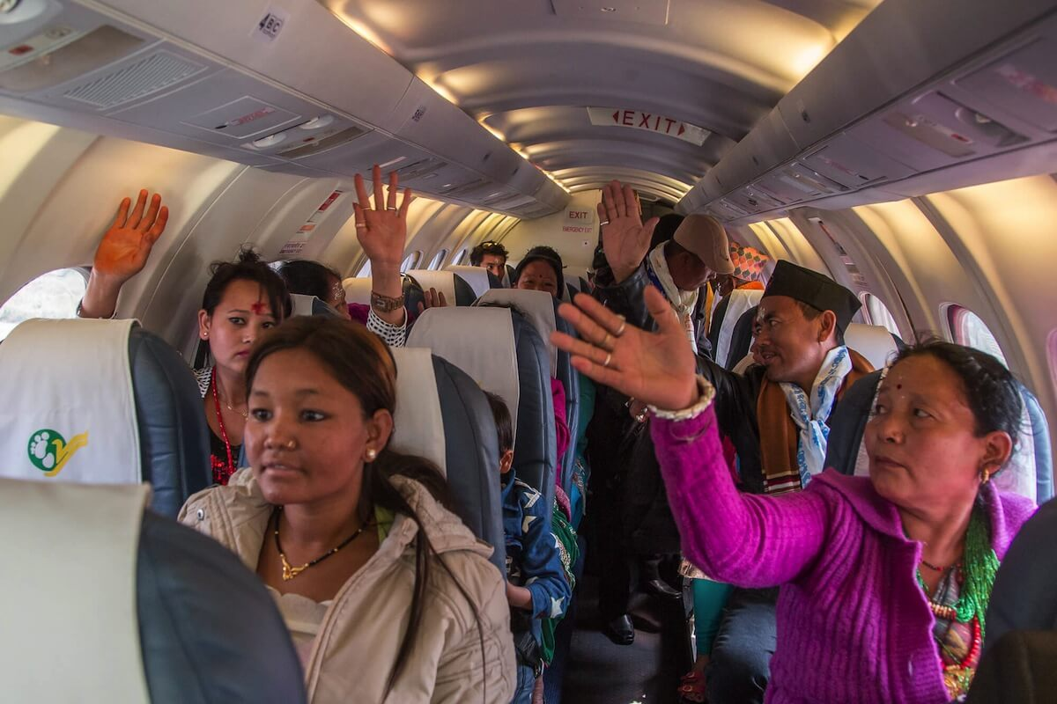
Leaving the Refugee Camp

Slide 12
When a family arrives, a lot needs to happen in short amount of time…

Slide 13
Transportation
Employment
Food
Housing
English as a Second Language Classes
Immunizations
Medical Appointments
Cultural Understanding
Furniture
School Registration
Clothing
Development of Skills

Slide 14
More to come next week!
Notes:
Next week, meet the Neupane (New-PA) family (through stories) and how Salem Church is involved in Refugee Resettlement!

